Slide 1
Cube Maintenance
当数据源的数据发生变化时，需要对数据方体（采用各种压缩方法缩减后的数据方体）中的数据进行相应的维护。
重新计算：简单方法，计算量太大
增量维护：在已有的数据方体基础上进行调整。

Slide 2
Cube Maintenance
对于不同的聚集函数，增量维护的方法和代价不一样
  分布型聚集函数：具有可以累计的特性，非常适合于增量维护。这类函数称为可自维护型（self-maintainable）聚集函数。
  代数型聚集函数：可以转化为分布函数，也是可自维护型函数。
  整体型聚集函数：在计算的时候需要所有的数据，很难进行增量维护，被称为不可自维护型

Slide 3
Cube Maintenance
大多数增量维护的算法都是针对可自维护型函数。
对不可自维护型函数，通常采用近似的方法，维护一个统计信息，当数据源发生改变的时候，对统计信息进行更新，然后根据更新后的统计信息估计查询结果。

Slide 4
Cube Maintenance
设计增量维护算法的困难主要在于：
  要同时支持三种类型的聚集函数。
  维护算法的效率必须高于重新计算的效率，
    必须能够对增加的数据进行批量更新。
    设计好的批量更新算法是至关重要的。

Slide 5
Cube Maintenance
介绍我们自己的一项工作
针对Quotient Cube进行维护
  Incremental maintenance of quotient cube for median. KDD 2004: 226-235

Slide 6
Condensed 和 Quotient比较
  a1b1c1
  a1b1c2
  a2b2c1
Quotient cube: 分为5个等价类
Condensed Cube
  a1b1c1 是BC AC ABC上的单元组
  a1b1c2 是BC AC ABC上的单元组
  a2b2c1 是A B AB AC BC ABC上的单元组

Slide 7
每个等价类有上届和下届，上届是唯一的。
每个等价类本身是一个格结构
上届和所对应的基元组ID集合之间是最大匹配。
计算Quotient Cube的过程就是求每个等价类的下界和上届的过程。
运用BUC算法求上届的过程体现close原理

Slide 8
Quotient Cube的维护
挑战：
Quotient Cube的等价类会变。
  例如，当插入一条新的元组时，原来的等价类可能需要分解。
  而当删除一条元组时，原来的等价类可能需要合并
当聚集函数是Median等综合聚集函数时，维护更难。
  因为计算新的聚集值需要所有的历史数据，无法实现增量维护。时间和空间开销太大

Slide 9
一个例子
C9
all:28
all:23
C10
C1
C7
a₁:9
c₁:20
a₁:14
b₁:13
c₁:25
a₂:4
a₃:10
b₂:10
c₂:3
b₃:5
C2
C11
a₂b₁:4
a₃c₁:10
b₂c₁:10
b₁c₂:3
a₁c₁:11
b₃c₁:5
a₁c₁:6
a₁b₁:9
a₁c₂:3
b₁c₁:10
a2c1:4
a₃b₂:10
a₁b₃:5
C2
C6
a₃b₂c₁:10
a₁b₁c₂:3
a₁b₃c₁:5
a₁b₁c₁:6
a₂b₁c₁:4
C3
C5
C8
C4
C12

Slide 10
维护策略
新插入一条元组可以对一个已有的等价类作如下改变
  使某个等价类的聚集值发生改变 (Value Modified Class)
  使某个等价类分裂成两个(New Class and its Generator)
还有一些等价类不做任何改变（Dump Class）

Slide 11
维护策略(Cont.)
C9
C9
C7
C1
C7
C1
C10
C6
C2
C6
C11
C2
C8
C5
C3
C4
C8
C5
C12
C3
C4
C7,C9 是value modified class
C10是new class, C2是generator
C11是new class, C3是generator
C12是new class, no generator (special case, introducing virtual class)
其他是dump class
Notes:
Within the framework , we address two technical problems . One is to design algorithms… the other problem is to recycle frequent patterns to speed up subsequent mining. We give two approaches.

Slide 12
维护策略(Cont.)
找出各种类型等价类的特征，针对不同类型的等价类对它们分别进行维护

Slide 13
维护策略(Cont.)
观察发现，当一个新的元组和一个旧的等价类的上届匹配的时候，新元组的插入将会引起等价类聚集值的改变
由于等价类的上届是最综合的数据元素，只要元组与它匹配，则与该等价类中的每一个数据元素都匹配。因此，在这种情况下，旧的等价类不需要分裂。

Slide 14
维护策略(Cont.)
属性1 [修改类]
如果一个类C_{m}满足条件：C_{m}.upp⊆t.cell
则该类是一个需要修改的类，C_{m}.v = C_{m}.v+t.v。
t的维值集合t.cell如果包含类C_{m}的上届C_{m}.upp，则意味着元组t对类C_{m}的聚集值有贡献，因此需要对类C_{m}的聚集值进行更新。
比如，由于c1⊆ a1b3c1，等价类C7的聚集值从20改为25。

Slide 15
维护策略(Cont.)
属性2 [新类的特征]
新类C_{n}具有特征C_{n}.upp=C_{g}.upp∩t.cell，
其中C_{g}是一个旧类。C_{g}称为C_{n}的生成者。
元组t的维值集合t.cell和某个旧类的上届相交表示元组t对类C_{g}中的部分元素的聚集值作出了贡献。由于此时旧类C_{g}的所有元素所包含的底层元组不一样了，所以此时旧类C_{g}必须拆分成两个类。

Slide 16
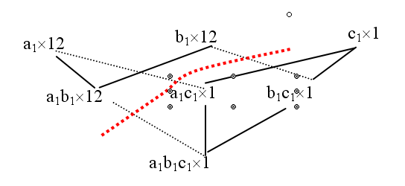
维护策略(Cont.)
一个极端的例子：假设基表R中原来只有一个元组,
  a1 b1 c1 10
旧的quotient数据方体只有一个类
  上届是： a1, b1, c1
  下界是：a1b1c1
往R里加一个新元组
a1 b1 c2 5

Slide 17
维护策略(Cont.)
C1分成两个类：
  C2：下界是a1, b1 上届是a1b1
  C1′：下界是c1 上届是a1b1c1
新类C2是从旧类C1拆分出来的。C1被称作C2的生成者。请注意，拆分之后旧类C1 的下届从{a1, b1, c1}变为{c1}。

Slide 18
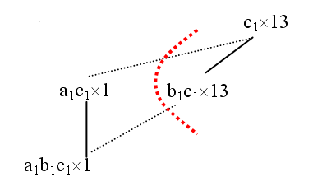
维护策略(Cont.)
再次加入元组：
a2 b1 c1 5
维护的重要任务就是：从旧类中找出那些需要进行拆分的类（生成者），然后由它们生成新类。

Slide 19
维护策略(Cont.)
属性7.3 [生成者的特征]
如果不存在某个旧类Z∈Φ使得X.upp=Z.upp，则C_{g}=GLB{Y∈Φ|X.upp=Y.upp ∩t.cell}是新类X∈Φ′的生成者。
可能有多个旧类能够和t.cell相交并产生相同的交集。这时，类格的GLB（Greatest Lower Bound）是生成者。

Slide 20
维护策略(Cont.)
考虑相继插入如下元组的情况
  a1b1c1
  a1b1c2
  a1b2c2

Slide 21
维护算法
采用了两种技术
  Addset数据结构
  Sliding Window技术
Notes:
Within the framework , we address two technical problems . One is to design algorithms… the other problem is to recycle frequent patterns to speed up subsequent mining. We give two approaches.

Slide 22
Addset 数据结构
Naive Method to maintain median
  Store a set of measure (Measure Set) for each cell
  Update the measure set and re-compute the aggregation Median when new tuples are inserted.
  Problem: Expensive for the large number of cells and tuples

Slide 23
Addset data structure: Motivation (cont.)
C9:{6,3,4,10}
Quotient cube helps to reduce this storage requirement
  Store only one measure set for each equivalence class
C7:{6, 4,10}
C1:{6,3,4}
C6:{6, 4}
C2:{6,3}
C8:{10}
C5:{4}
C3:{6}
C4:{3}
Problem: Redundancy! For example: 6,4,10 in C7 and C9

Slide 24
Naïve Addset data structure
Store the measure set difference between new class and its generator (Addset)
Space saving: about 2 times (from 18 to 10)
Family tree
Combine the addset along its family linkage path, we get the measure set, for example: MS(C1)={3}∪{6}∪{4}={3,6,4}
C9:{3}
C7:{6, 4}
C1:{3}
C6:{6}
C2:{3}
C8:{10}
C5:{4}
C3:{6}
C4:{3}
C0:{}
Problem: Measure set computation cost increases with the length of family path

Slide 25
Dynamical Materialization of Addset
In order to get some tradeoff between space and time, dynamically materialize some class in the process of maintenance
  Pseudo class: store addset
  Materialized class: store actual measure set
K
{9}
L
{11}
M
{12}
H
{7}
I
{8}
J
{2,3,10}
E
{6}
{1,4,5}
F
G
{3}
B
{1,4}
C
{2}
D
{3}
To obtain the actual measure set of a pseudo class
  only need to trace to its nearest materialized ancestor class instead of tree root.
A
{}

Slide 26
Dynamical Materialization of Addset(Cont.)
Which classes should be materialized?
  Similar to materialized view selection. If there is sufficient space, we can materialize more to save maintenance time; Otherwise, keep more classes to be pseudo to save storage space.
  In our case, the distance threshold is used to control the materialization of pseudo class, when the Distance between a pseudo class and its nearest exceeds the given threshold, it will materialized.
Distance: total number of measures in the addset on the path from a pseudo class to its nearest actual ancestor.

Slide 27
Slide Window
Motivation
  The addset reduces the storage requirement, however, computation of updated MEDIAN is still expensive.
  Moreover, extra processing is required to obtain the measure sets for pseudo class.
Important observation
  the number of elements that are larger and smaller than the median of n measures is the same
  By keep k measures in the sliding window, the median will still lie in the window even with k insertions.

Slide 28
Slide Window (Cont.)
Given a materialized class C_{m} with a sorted measure set S={X₀,x₁,…,x_{n-1}}, the median of one of its descendant pseudo class C_{d} can be computed as follows:
Slide Window
X₀
X_{low}
X_{med}
X_{high}
X_{n-1}
A
B
C
D
A: X_{med} move ½ position to left
B: X_{med} move ½ position to left, X_{low} move 1 position to the right
C: X_{med} move ½ position to right, X_{high} move 1 position to the left
D: X_{med} move ½ position to right

Slide 29
Slide Window (Cont.)
Restriction: Distance between C_{m} and C_{m} can not exceed the size of the slide window.
Solution: let the distance threshold smaller than the size of the sliding window.
Interestingly, the size of the sliding window can be a parameter to balance the space-time tradeoff.
  Equal to 1: all class are materialized, naïve quotient cube
  Equal or larger than the total number of tuples, all class are pseudo class, highest space reduction, but need to compute and sort all measures of a class when computing median.

Slide 30
Maintenance Algorithms
Single Tuple Maintenance
  Update a median quotient cube tuple by tuple
  Not so efficient
Batch Maintenance
  Update a median quotient cube in batch
  Very efficient

Slide 31
Single Maintenance Algorithm
Divide all class into buckets B[0],B[1],….
  Bucket B[i] contains all classes whose upper bound cardinality is i.
Iterate through the classes in each bucket in the order B[0],B[1],….
  Applying the proposition 1-3, modify the aggregations, split the classes,…
  Materialize those classes whose distance exceeds threshold (addset structure)
  Computer new median for all new and modified classes in depth-first order (sliding window )

Slide 32
Batch Maintenance Algorithm
Inspired by BUC algorithm
Novelty of our algorithm
  “Synchronize” partitioning on both existing classes and the new set of tuples
  Enhances efficiency 1: by grouping thples that share similar dimensional values together, the search for affected classes needs only to be done once
  Enhances efficiency 2: as the partitioning of classes done in synchronization with the tuple partitioning, the number of classes that are being checked is substantially reduced.

Slide 33
Batch Maintenance Algorithm (Cont.)
Recursively partitioning on tuple and class in a depth-first order
Check and update classes similar to previous Single maintenance algorithm
  Difference: the cell (not the whole tuple) is used as a representative to compare against the class

Slide 34

BUC: Partitioning
Usually, entire data set can’t fit in main memory
Sort distinct values, partition into blocks that fit
Continue processing
Optimizations
  Partitioning
    External Sorting, Hashing, Counting Sort
  Ordering dimensions to encourage pruning
    Cardinality, Skew, Correlation
  Collapsing duplicates
    Can’t do holistic aggregates anymore!

Slide 35
Batch Maintenance Example
call(1)
call(2)
call(3)
Cell:{all}
Cell:{a1}
Cell:{a1b1}
Cell:{a1b1c3}
a1b1c3
a1b1c4
a3b2c1
all
b1
c1
a1b1
b1c1
a1b1c1
a1b1c2
a2b1c1
a3b2c1
VC
a1b1c3
a1b1c4
a1b1
a1b1c1
a1b1c2
VC
a1b1c3
a1b1c4
a1b1
a1b1c1
a1b1c2
VC
a1b1c3
VC
call(4)
call(5)
Tuple partition
Cell:{a1b1c4}
Cell:{a3}
a1b1c4
VC
Cell:{a1c3}
Step(0)
Cell:{b1}
a1b1c3
VC
…
…
Sorted Class partition
Cell:{c4}
Cell:{a1c4}
Notes:
Complete row enumeration space. Obviously, it is not necessary to do such a complete enumeration. There is no space in

Slide 36
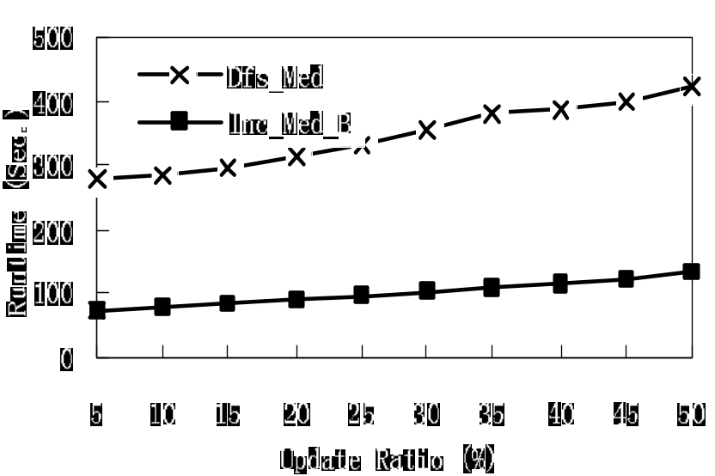
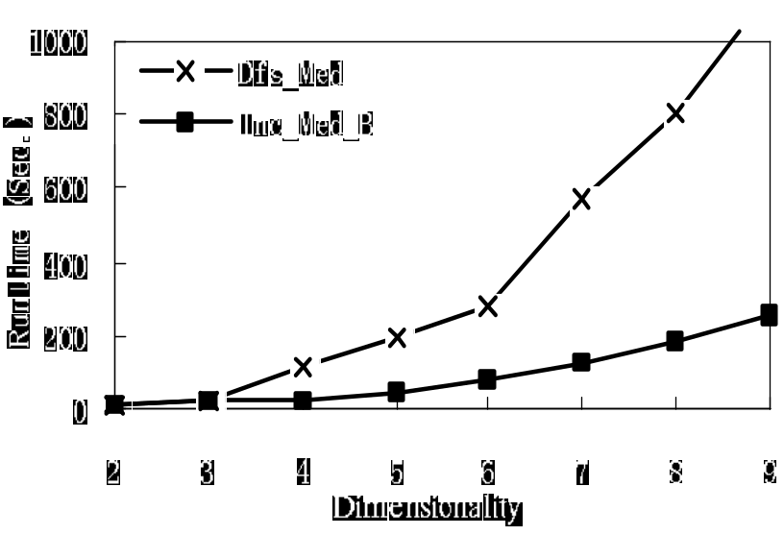
Maintenance Efficiency

Slide 37
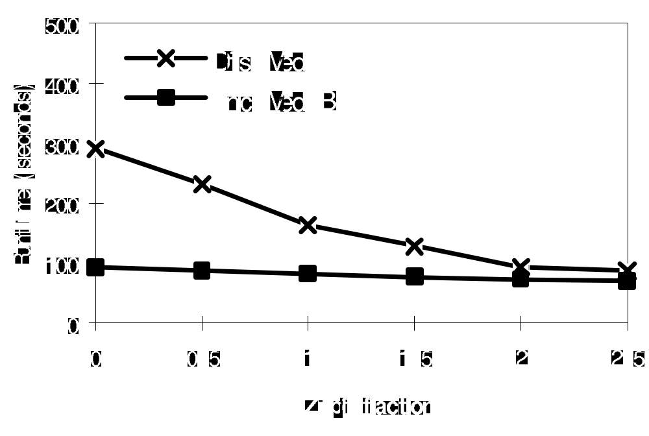
Impact of data skew

Slide 38
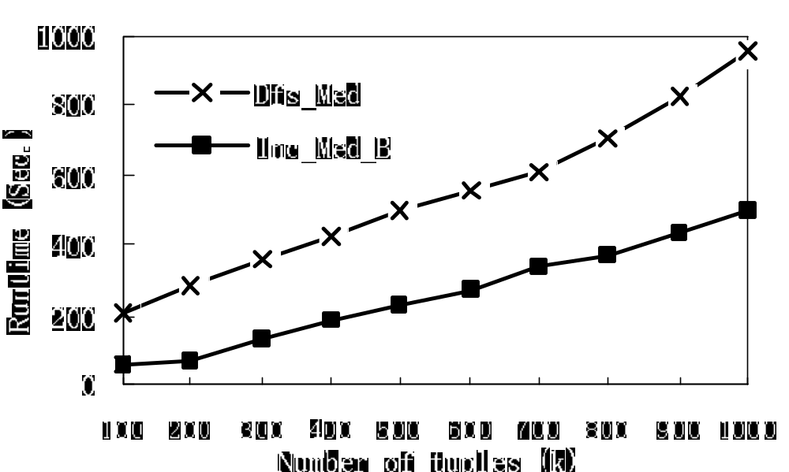
Scalability with the number of tuples

Slide 39
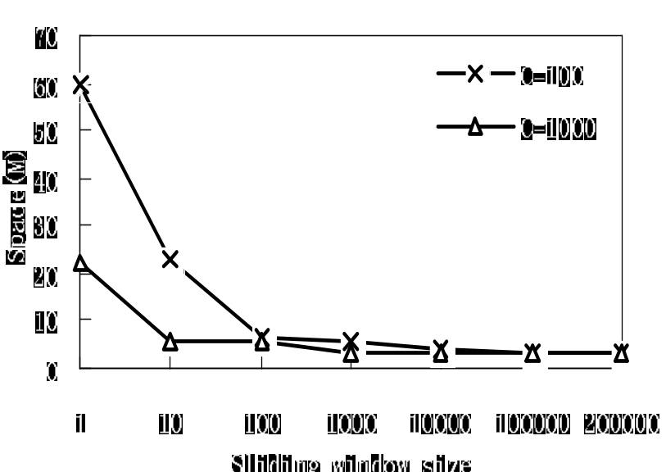
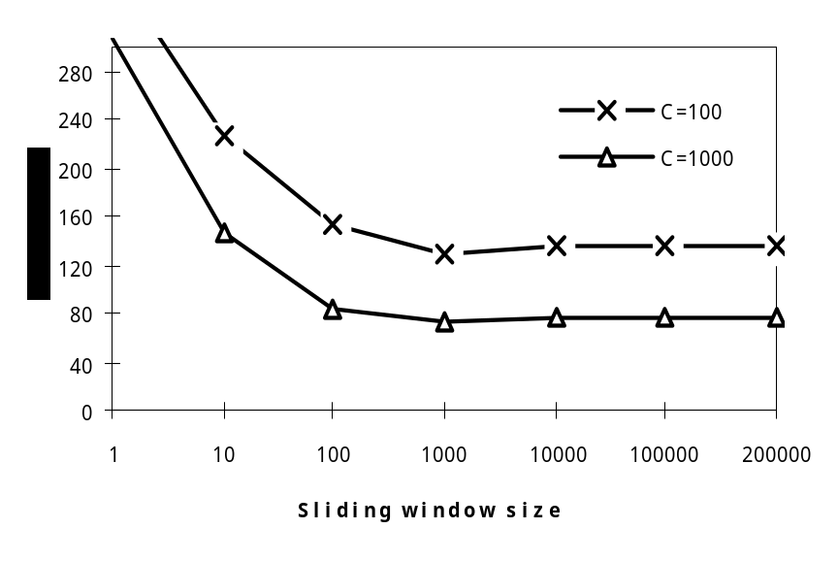
Effectiveness of Addset and Sliding Window

